Slide 1
B. Tech (IT)
Automated System for Generating Departmental Annual Report
Presented by:
Group 4
Under the supervision of:
Dr. Amitabha Nath
Department of Information Technology
North-Eastern Hill University

Slide 2
Outline
Problem Statement
Introduction
Objectives
Technologies/Tools used
Why React?
System Design
(i) System Architecture
(ii) Use Case (iii) DFD
Implementation and Working
Future scope
Conclusion
References

Slide 3
Problem Statement
Development of Automated System for Generating Departmental Annual Report

Slide 4
Objectives
Automate Data Collection
Structured and Efficient Workflow
Feedback and Notifications
Provide real-time insights
Reduce Workload
Ease of management
Data backup and Recovery

Slide 5

Introduction
Project Purpose: Developing an Automated System for Generating Annual Reports to streamline the reporting process for the department.
Technology: The system is being built using ReactJS.
Challenges Addressed: Manual data collection, inefficient, unstructured, time-consuming and error prone process.

Slide 6




Technologies/Tools Used
React: Java script library for building user interface.
Bootstrap: Frontend toolkit consisting of reusable codes for designing.
JavaScript: For managing backend.

Slide 7

MySQL: Stores and retrieves data for reports.
jsPDF: For desired report generation.

Slide 8
Why React?
Fast Rendering: React uses a virtual DOM that updates only what’s necessary, improving performance, especially for large data sets and interactive reports.
Rich Ecosystem: React has a vast community, extensive libraries, and third-party tools, making development faster and more flexible.
Simpler Learning Curve: React is often easier to learn, as it focuses only on the view layer.

Slide 9
Easy Integration: React can easily integrate with other technologies, such as APIs and databases like MySQL, for seamless data flow.
Strong Developer Support: Backed by Facebook and an active community, React ensures regular updates and long-term reliability.
Component Reusability: React’s component-based architecture is highly reusable and promotes code maintenance, making it ideal for scalable applications like report generation.
****

Slide 10
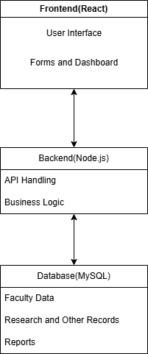
System Design (i)System Architecture

Slide 11
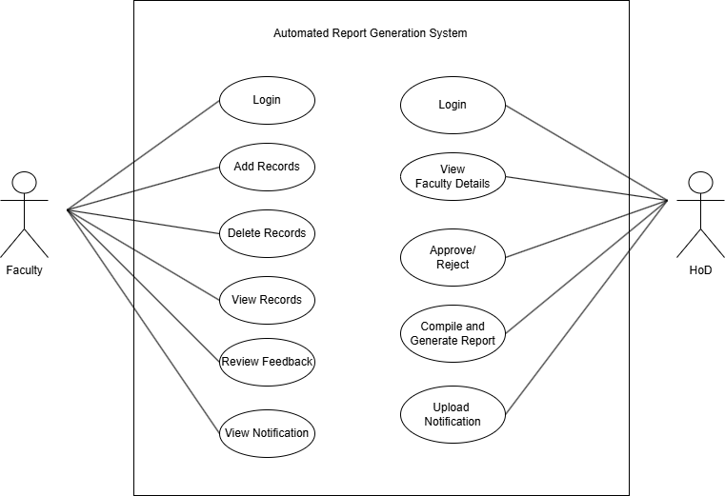
(ii) Use Case Diagram

Slide 12
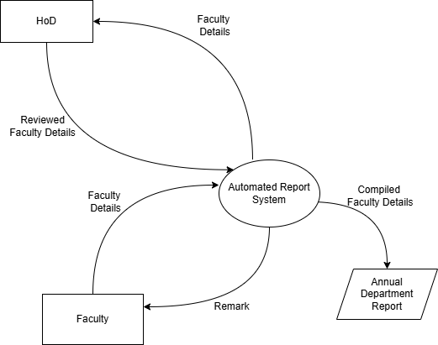
(iii) DFD Context Diagram (Level 0 ):

Slide 13
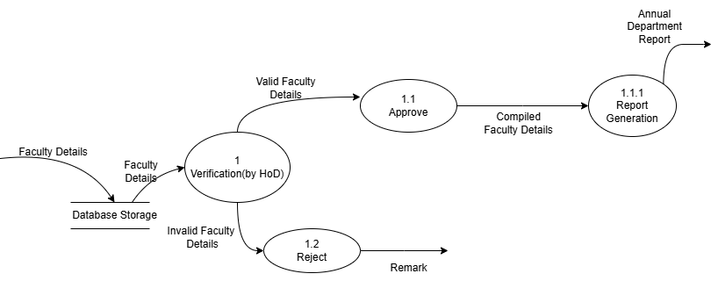
Level 1 DFD:

Slide 14

Implementation

Slide 15
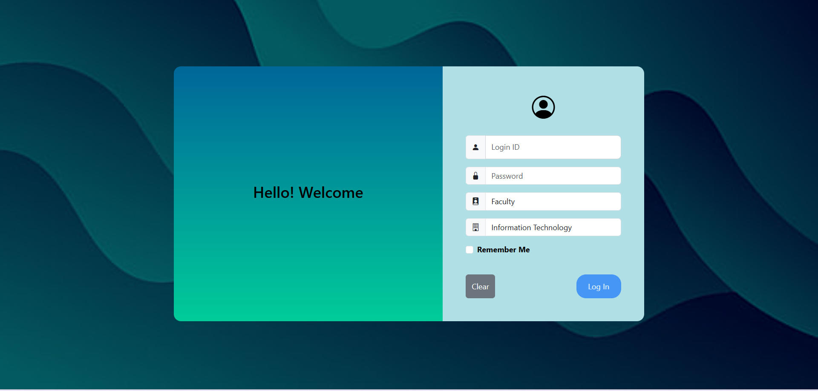
Login page

Slide 16
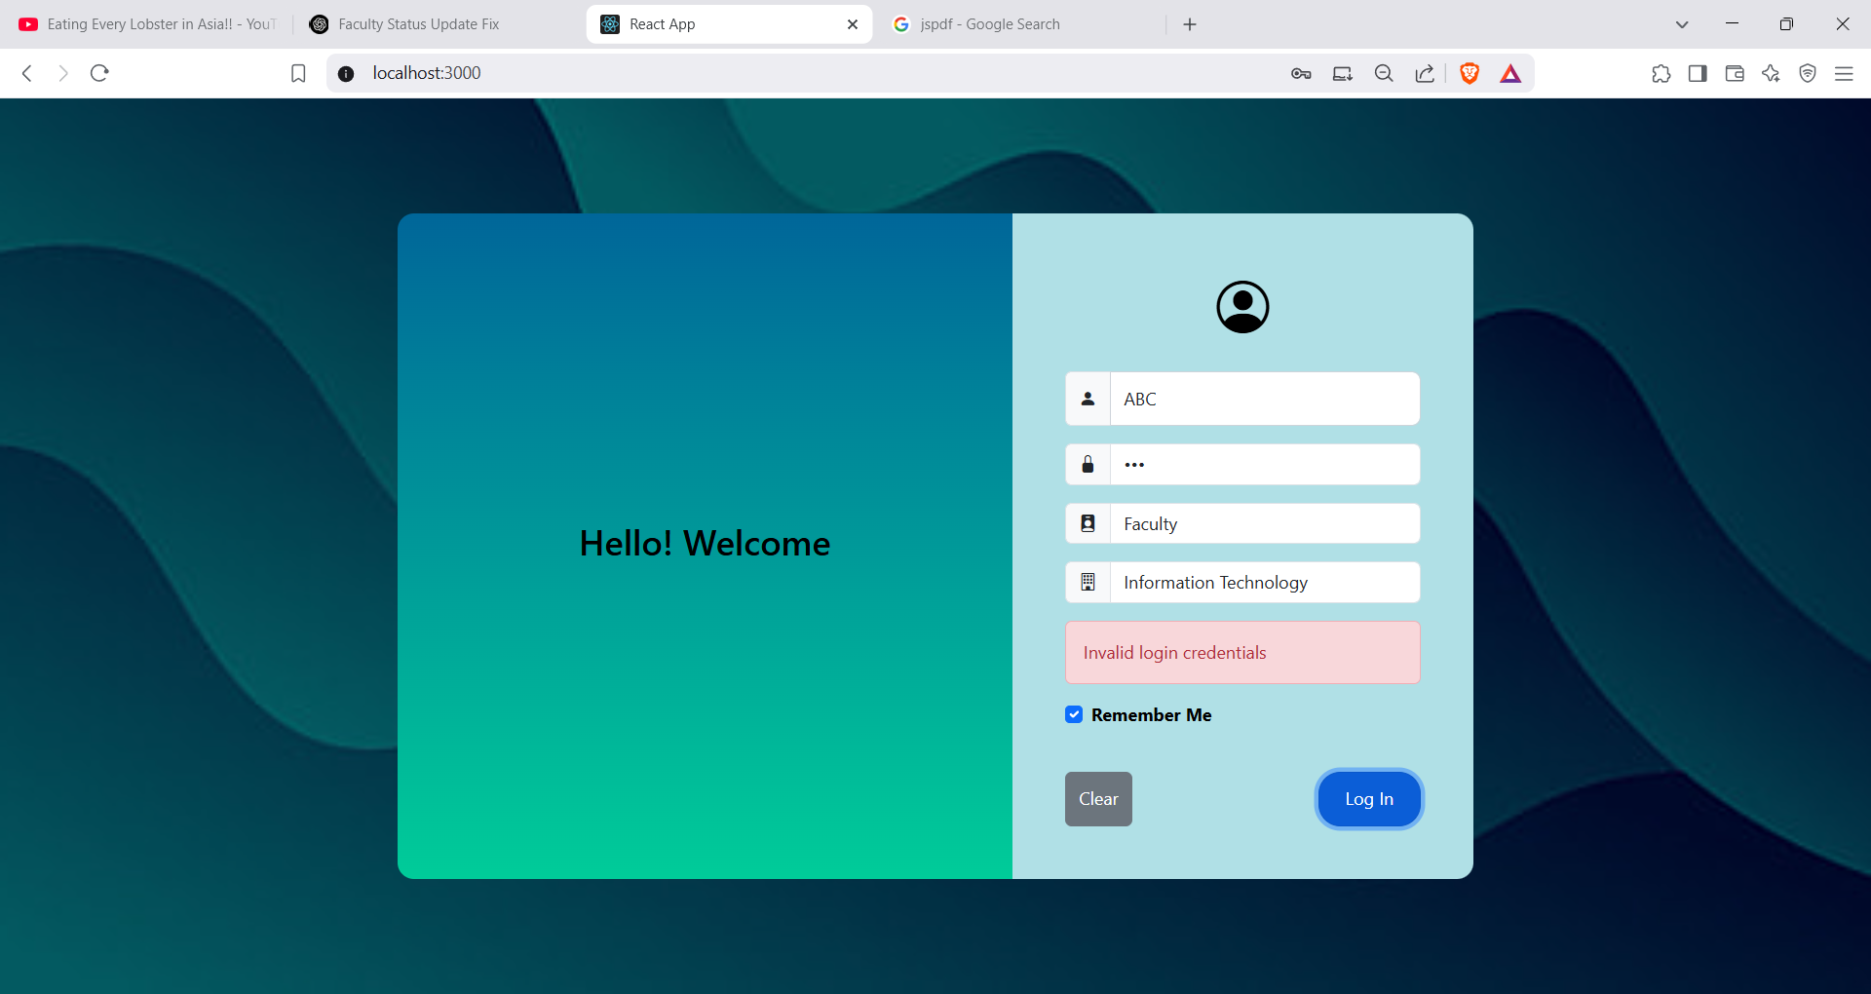
(i)Login with wrong credentials

Slide 17
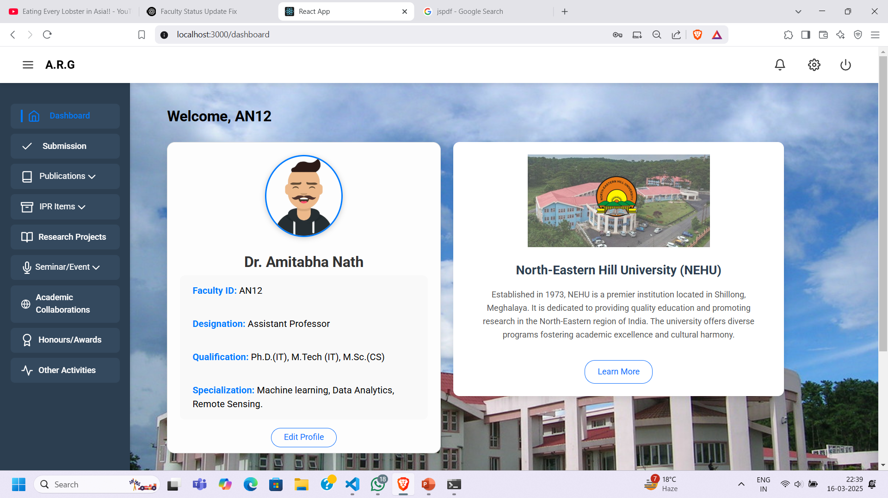
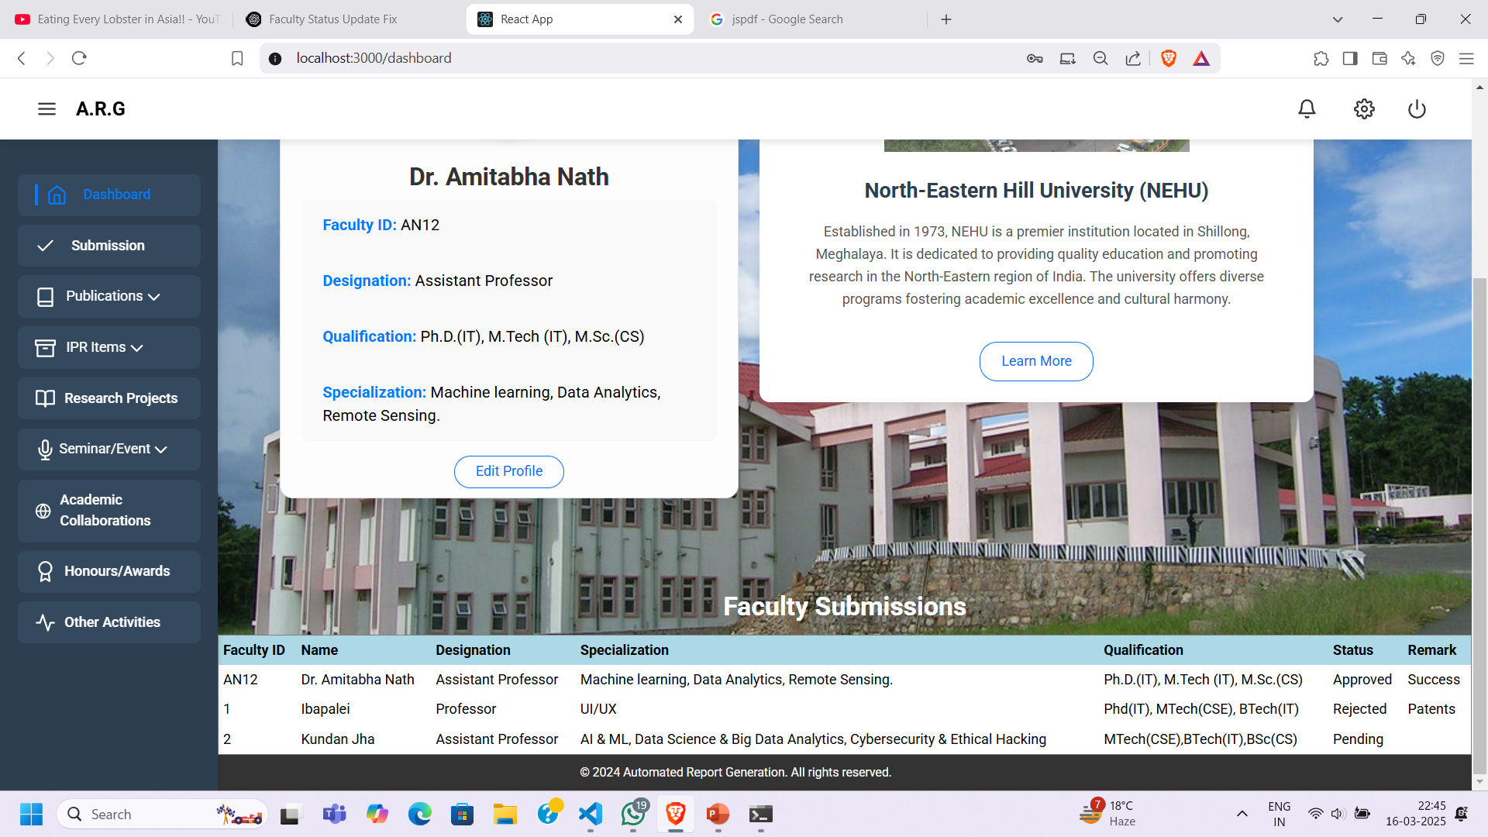
Faculty Dashboard

Slide 18
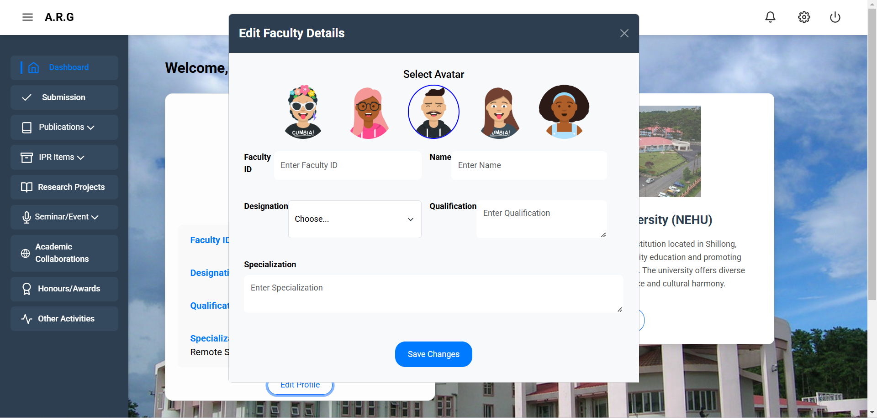
(i)Edit Profile Details

Slide 19
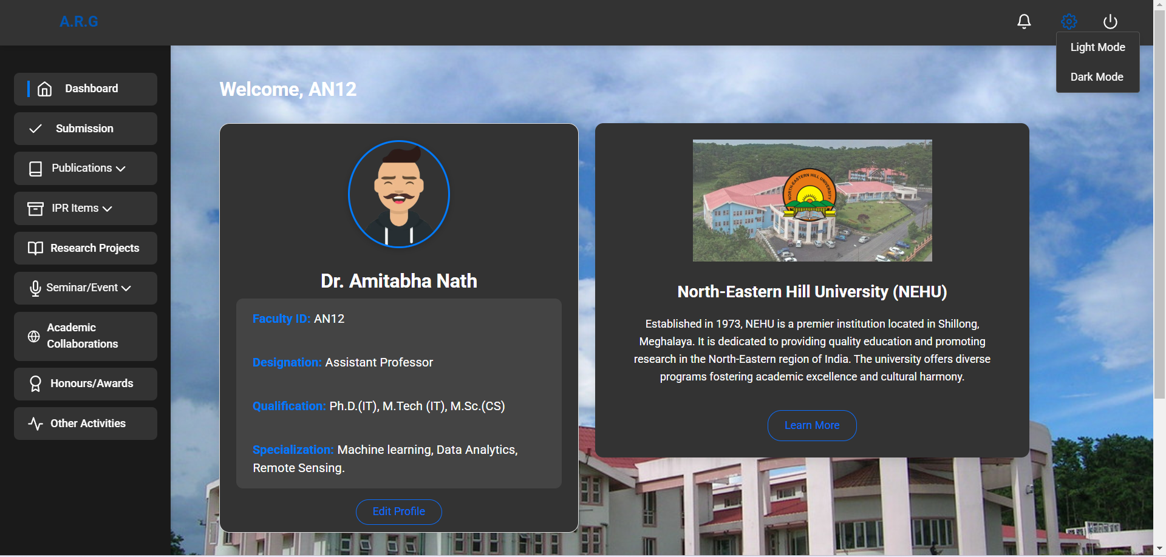
(ii) Modes(light or dark)

Slide 20
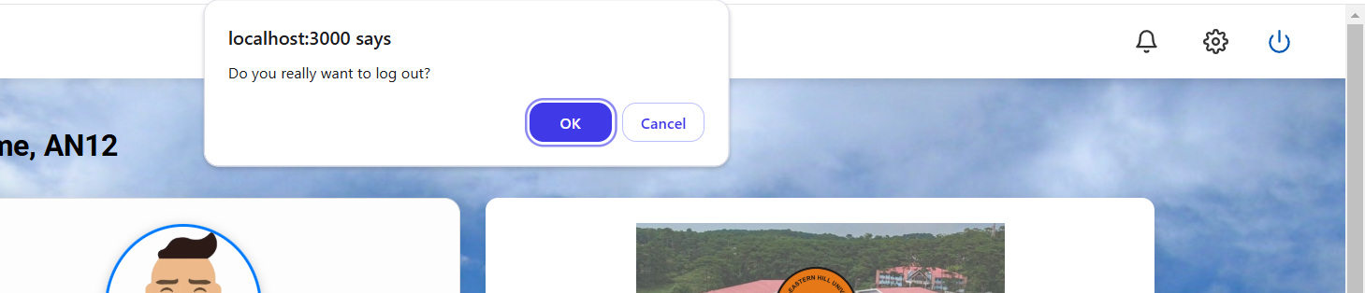
(iii) Log out

Slide 21
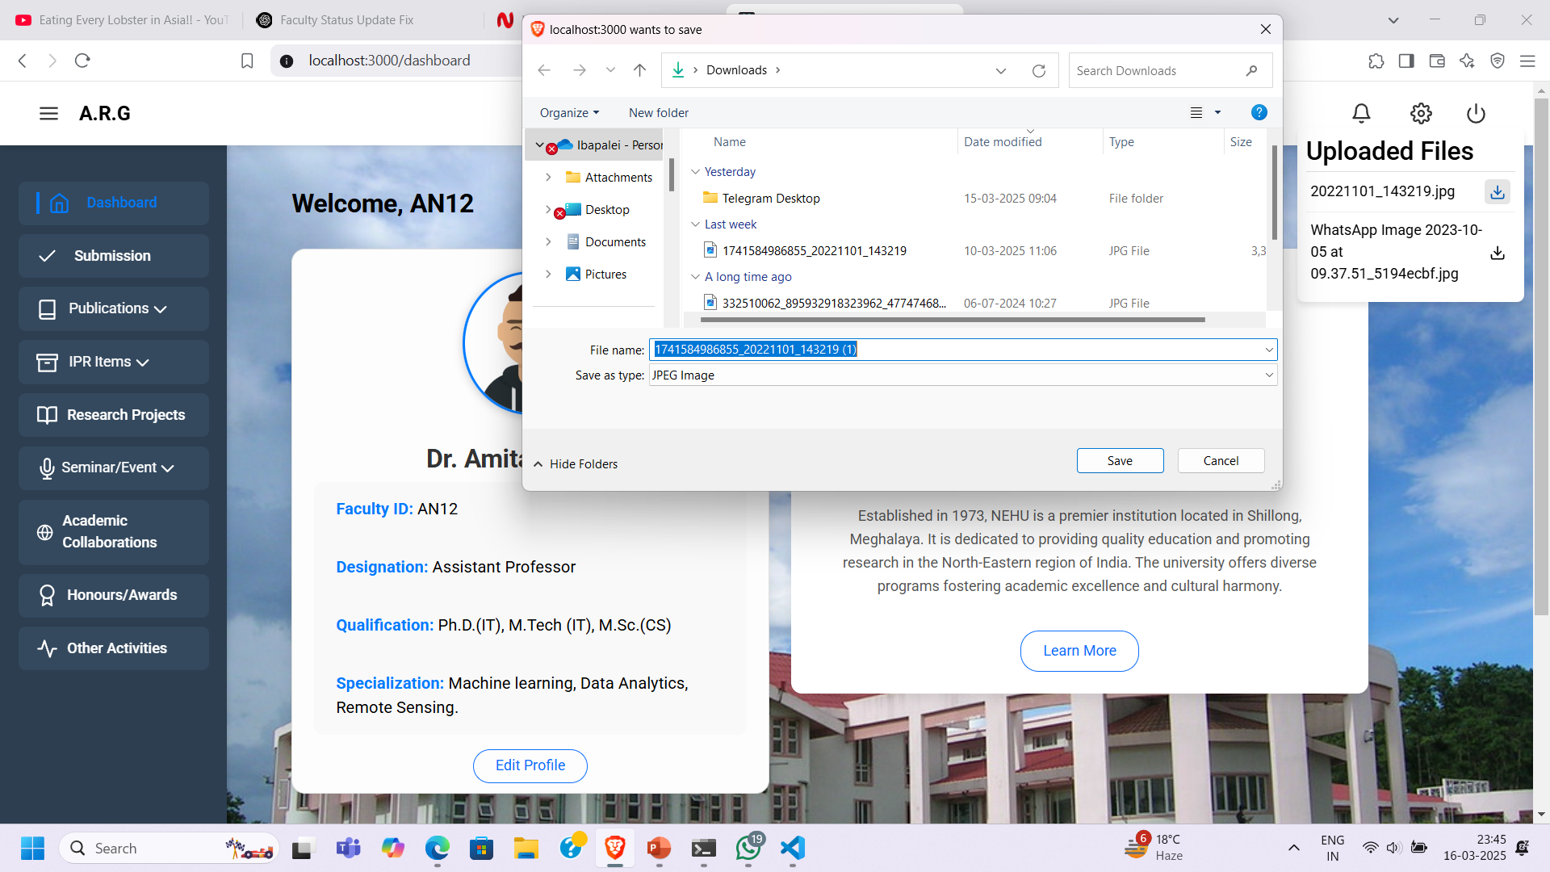
(iv) Uploaded Files

Slide 22
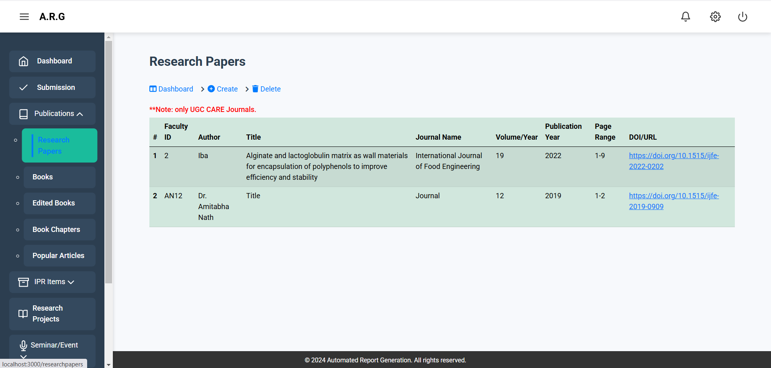
(v) Sidebar that leads to different pages faculty can fill details in

Slide 23
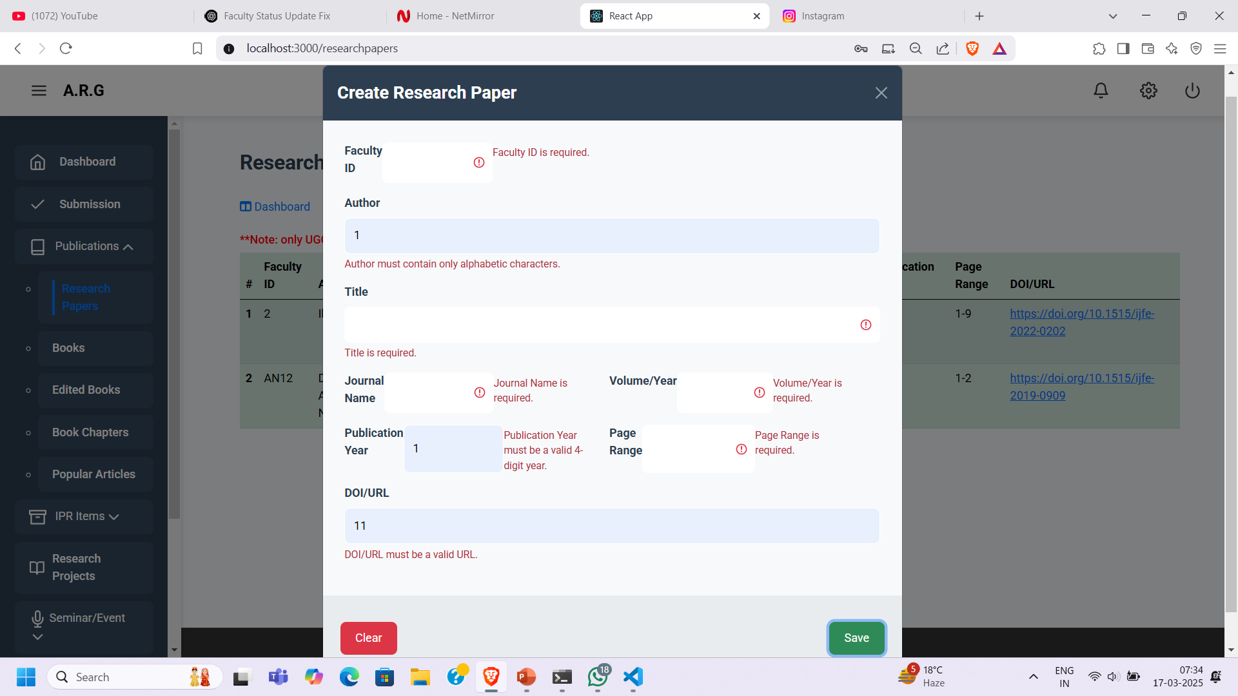
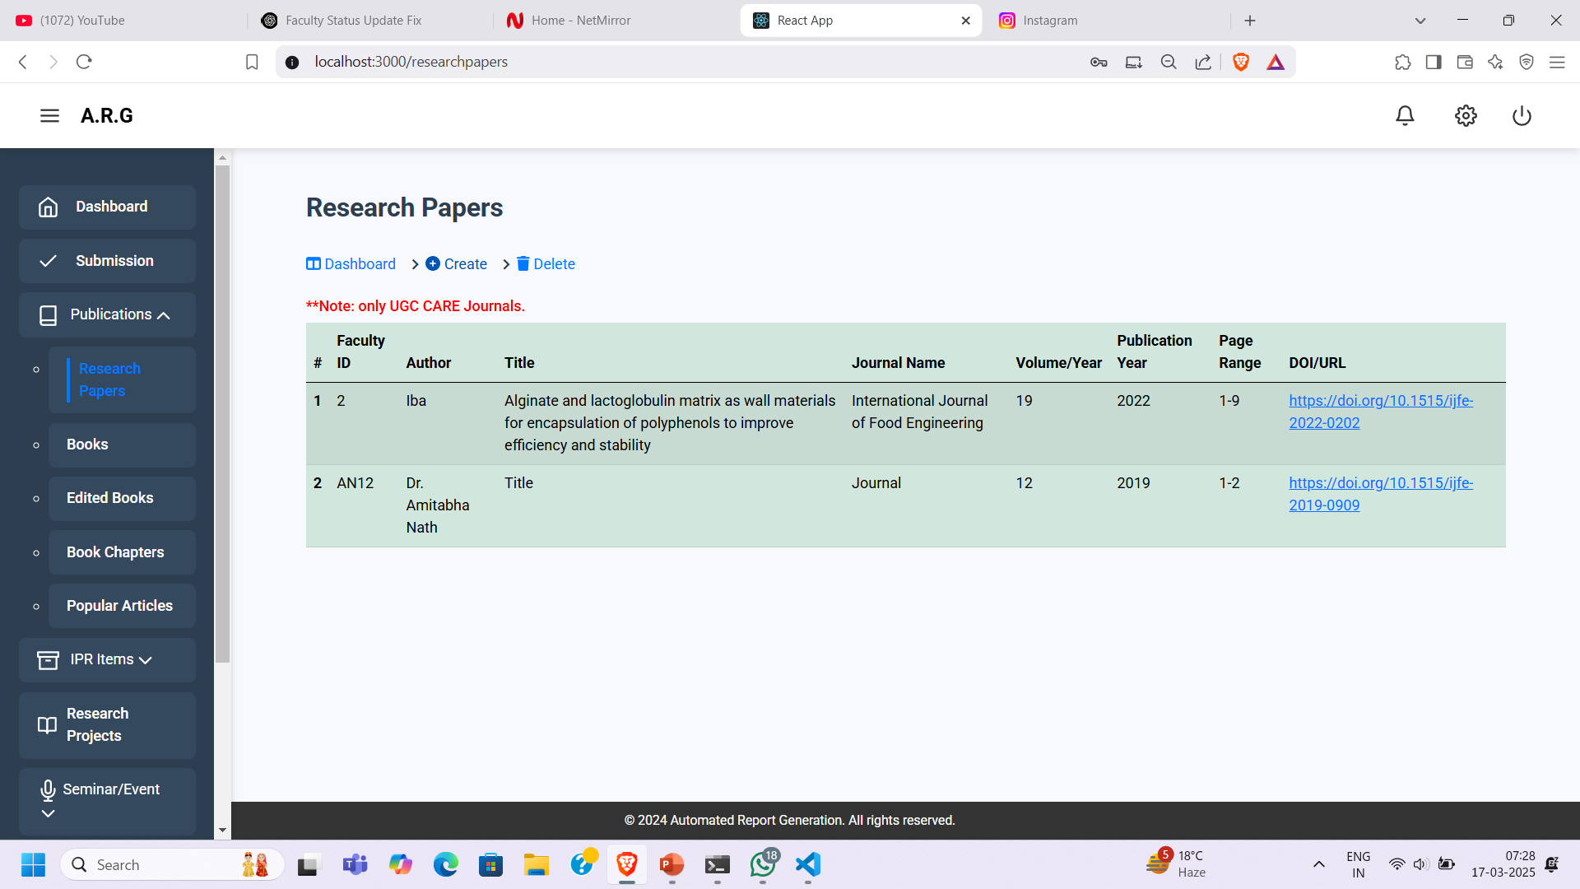
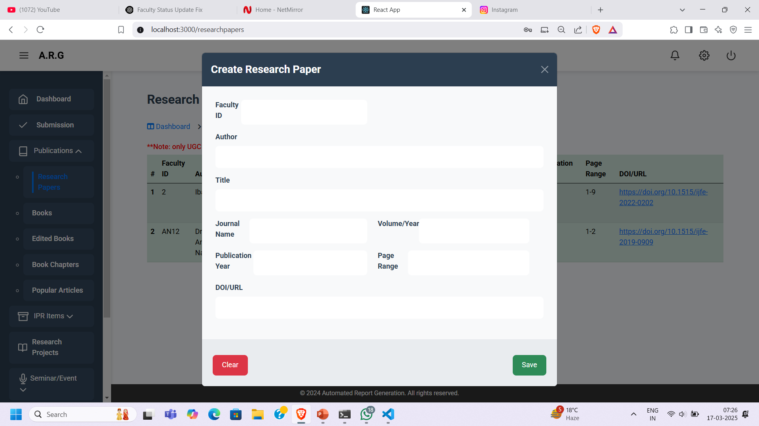
Faculty Submissions (i) Forms for adding new data

Slide 24

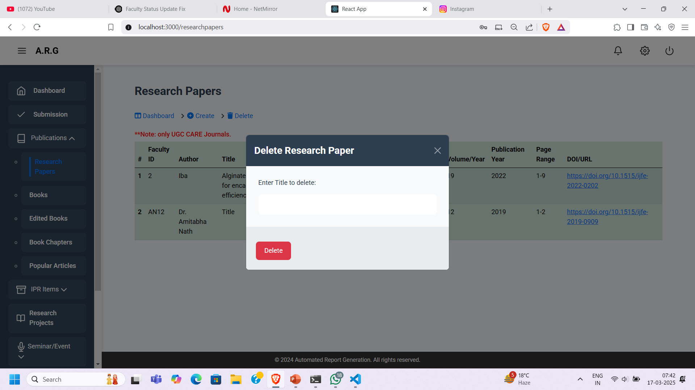
(ii) Form to delete existing data

Slide 25

(iii) Table which shows all existing data

Slide 26
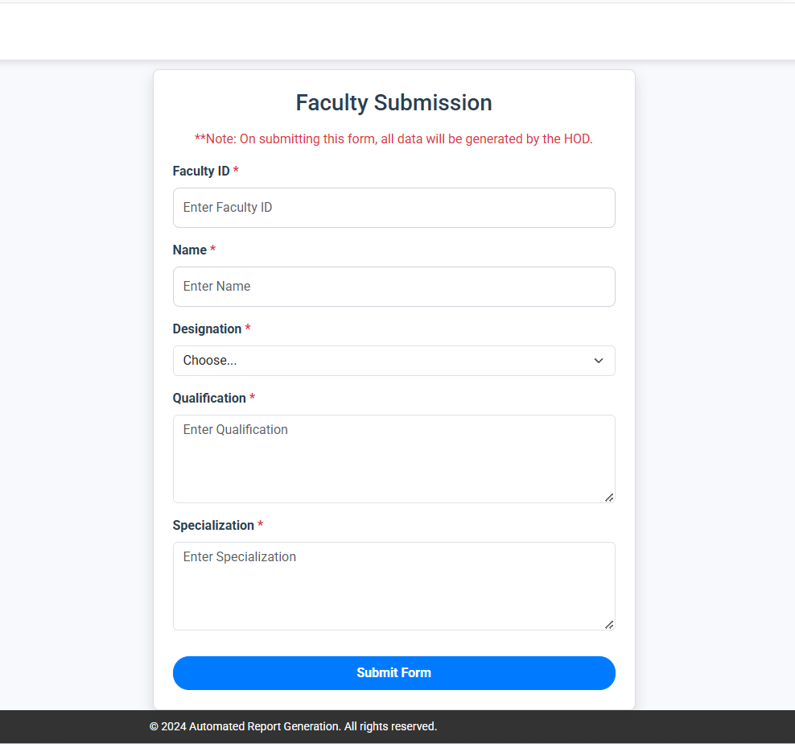
Final Submission form

Slide 27
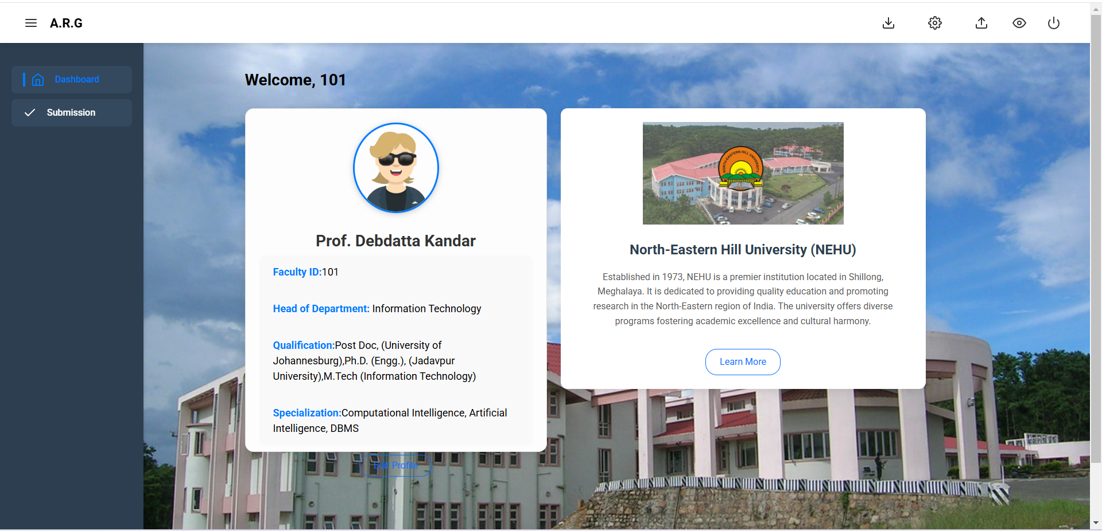
HoD Dashboard

Slide 28
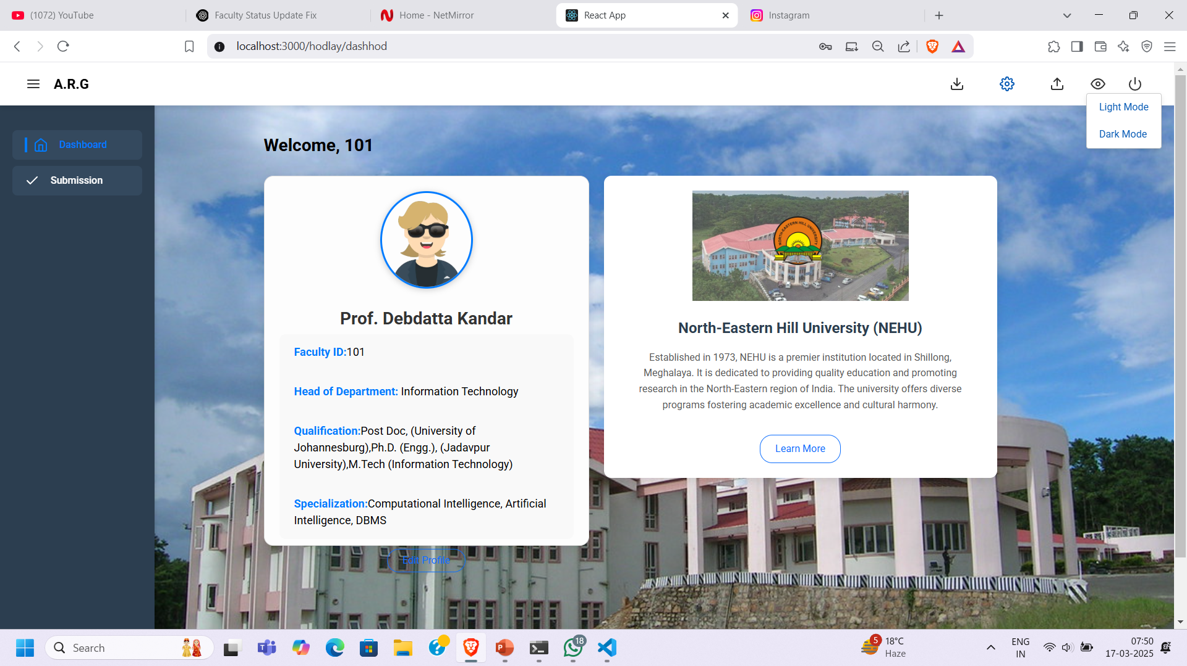
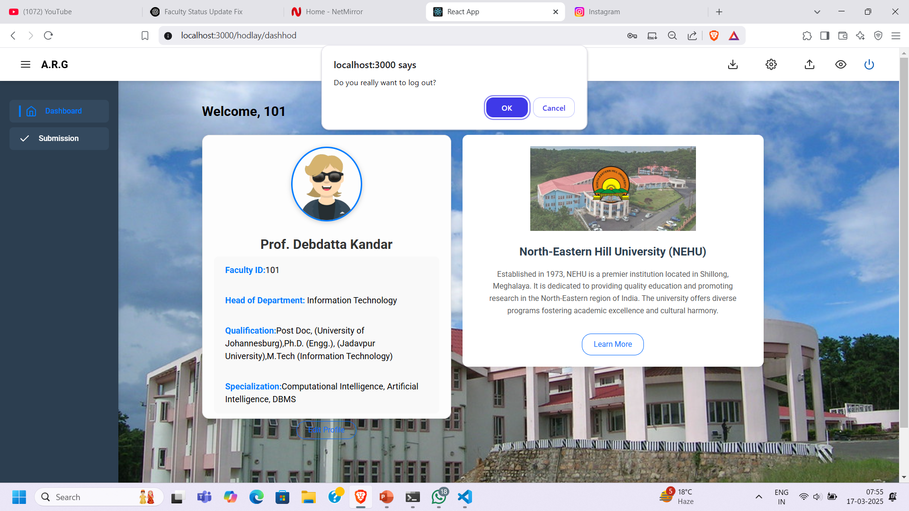
(i) Modes(light or dark)
(ii) Log out

Slide 29

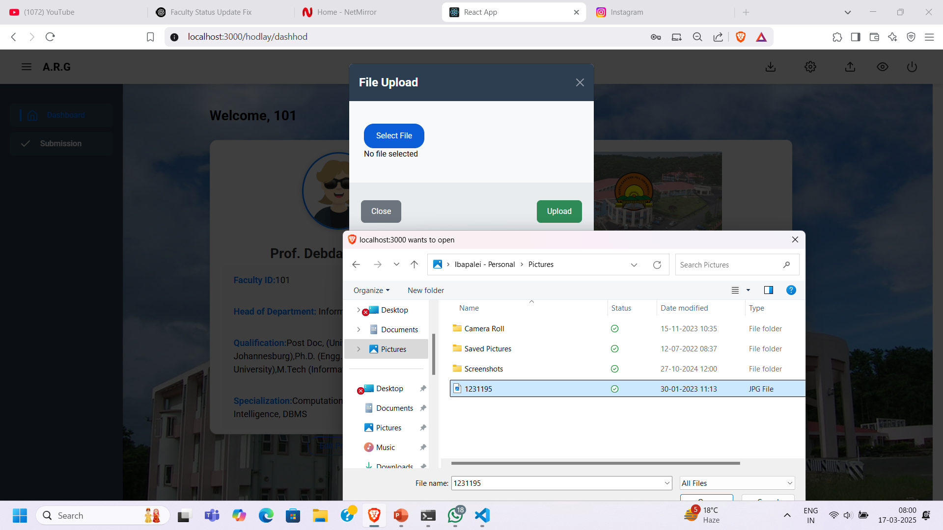
(iii) Upload files/notifications for faculty

Slide 30
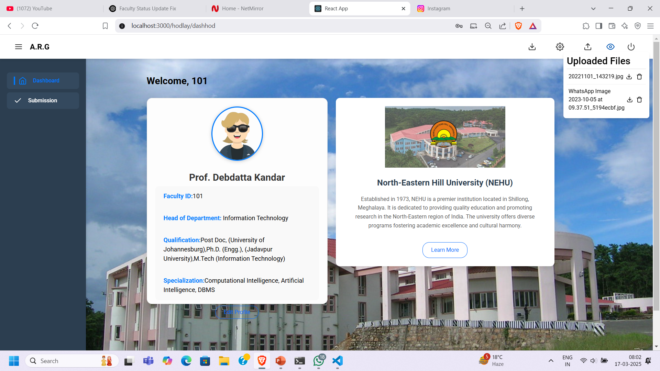
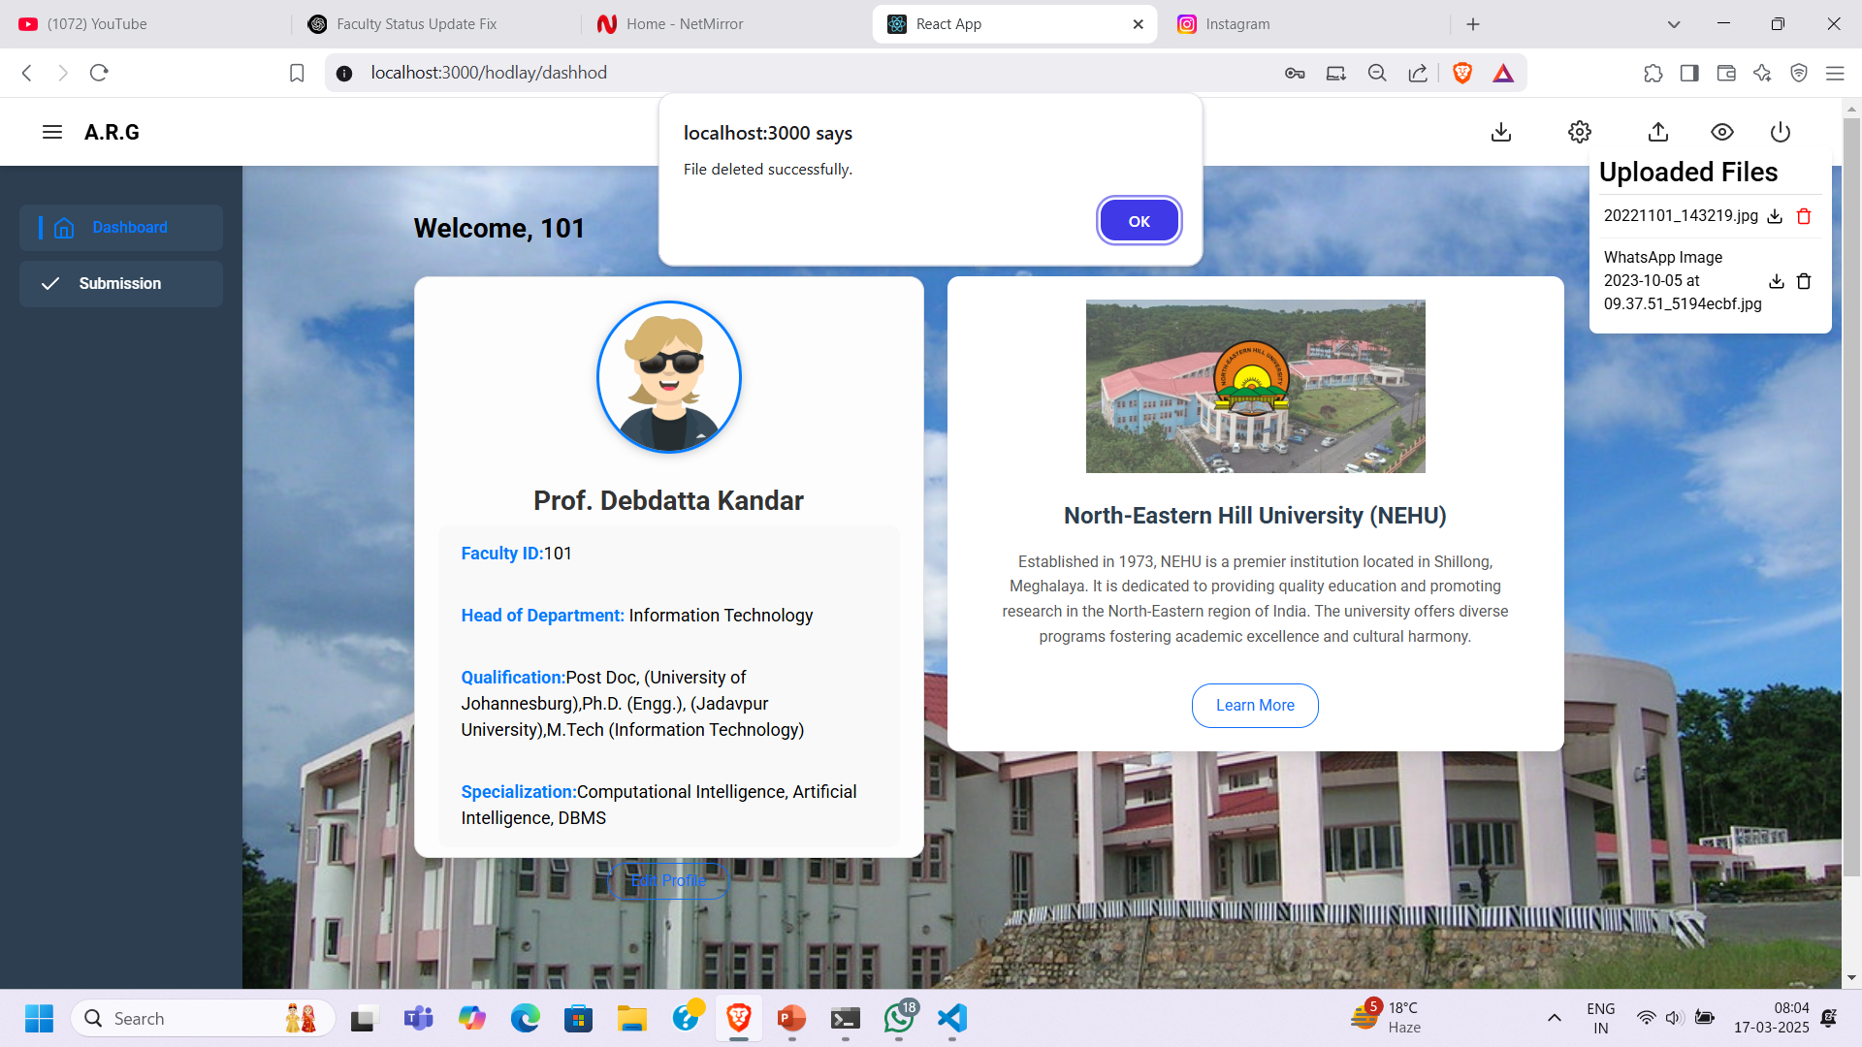
(iv)View/Delete uploaded files

Slide 31
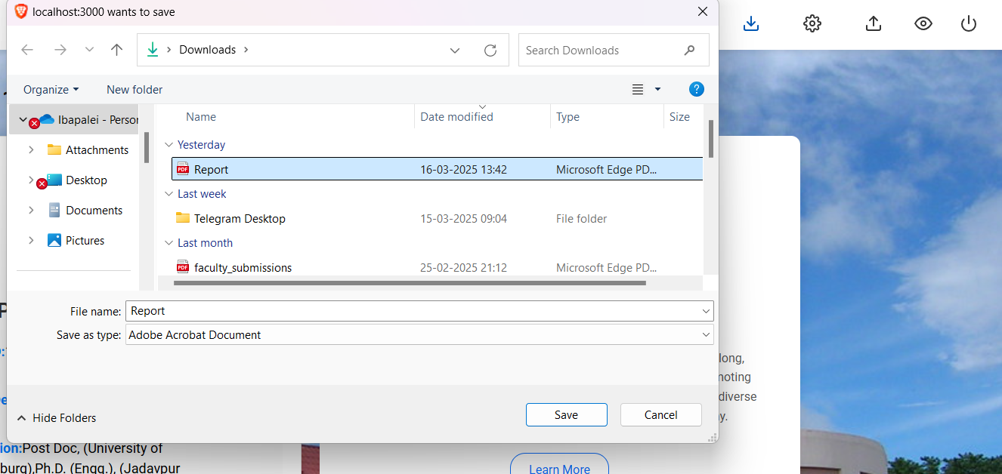
(v) Generate and Download Report

Slide 32
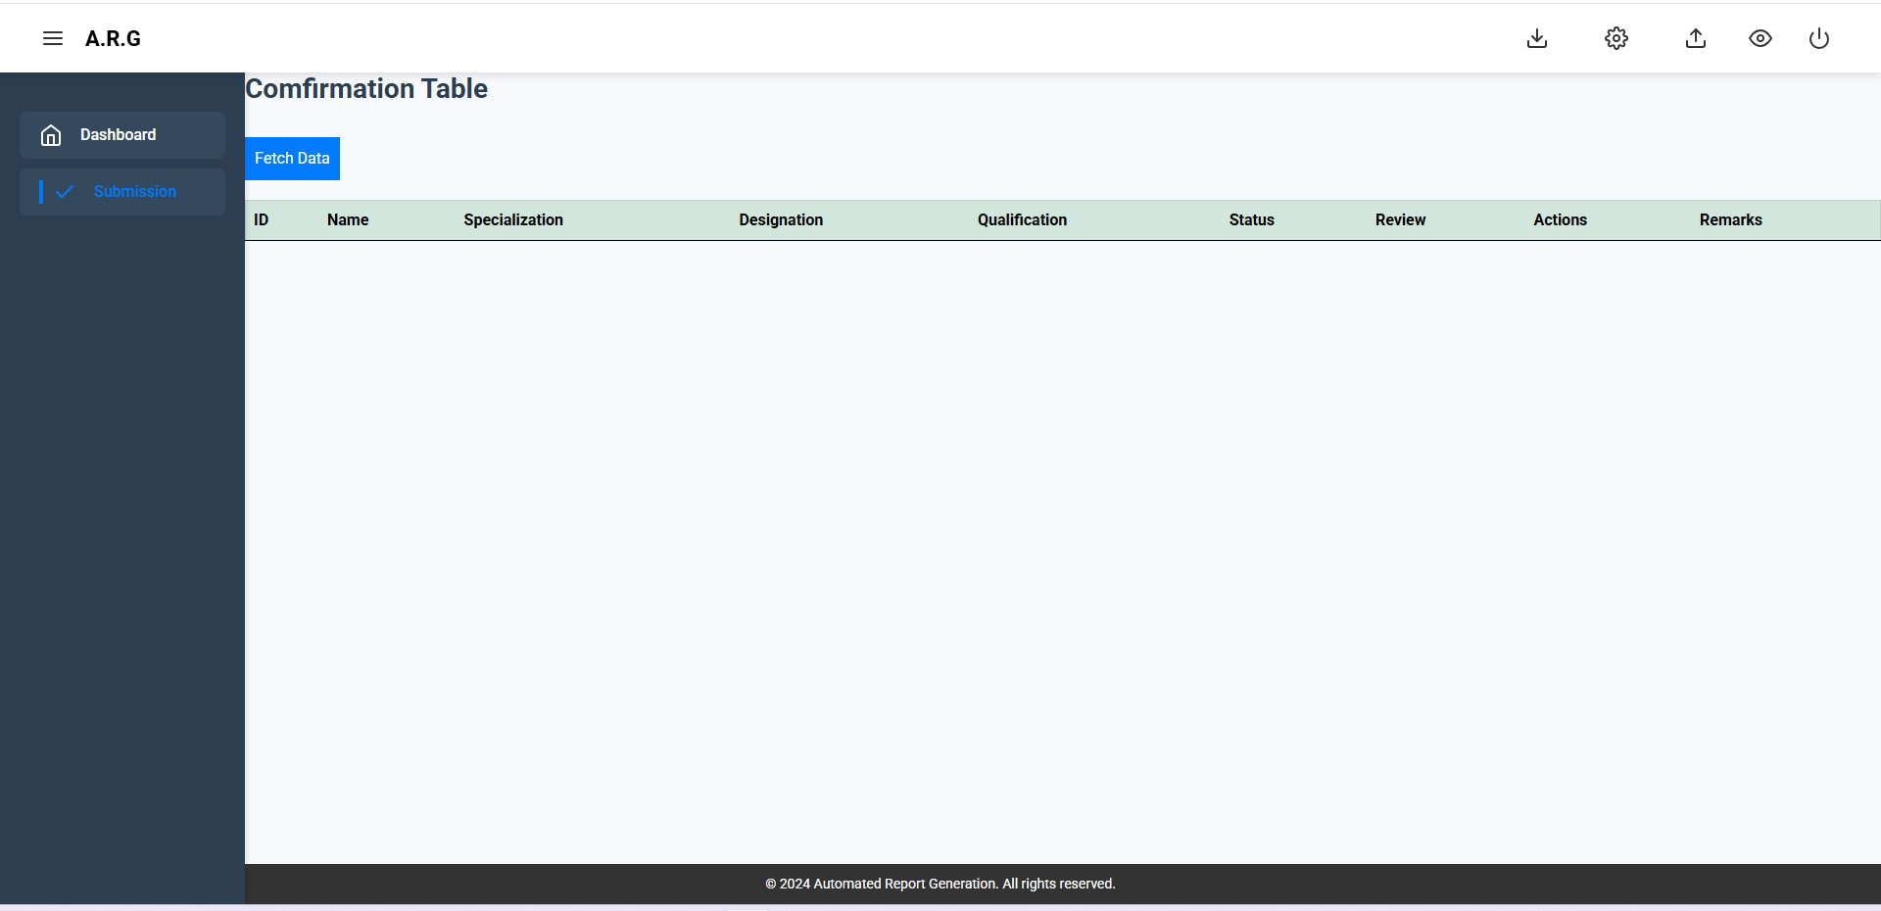
Sidebar option that leads to confirmation table

Slide 33
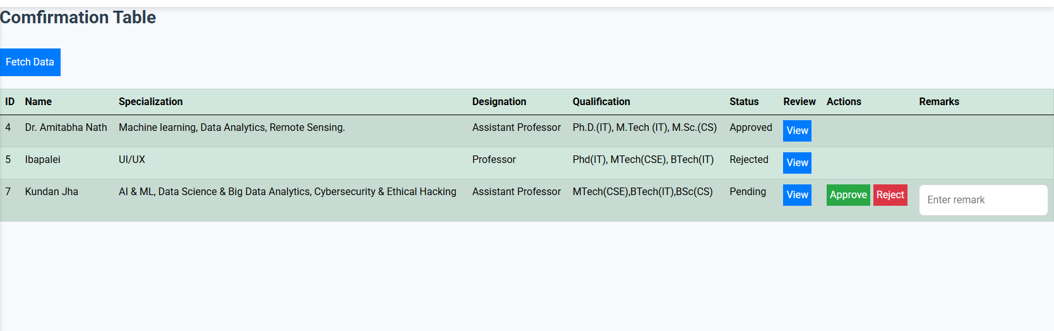
Fetching faculty details

Slide 34
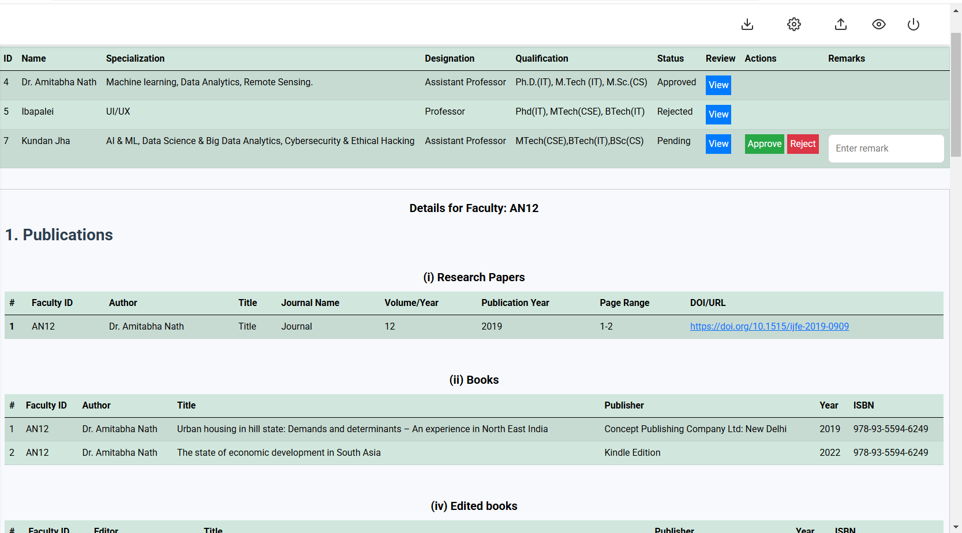
(i) Viewing data of a specific faculty

Slide 35
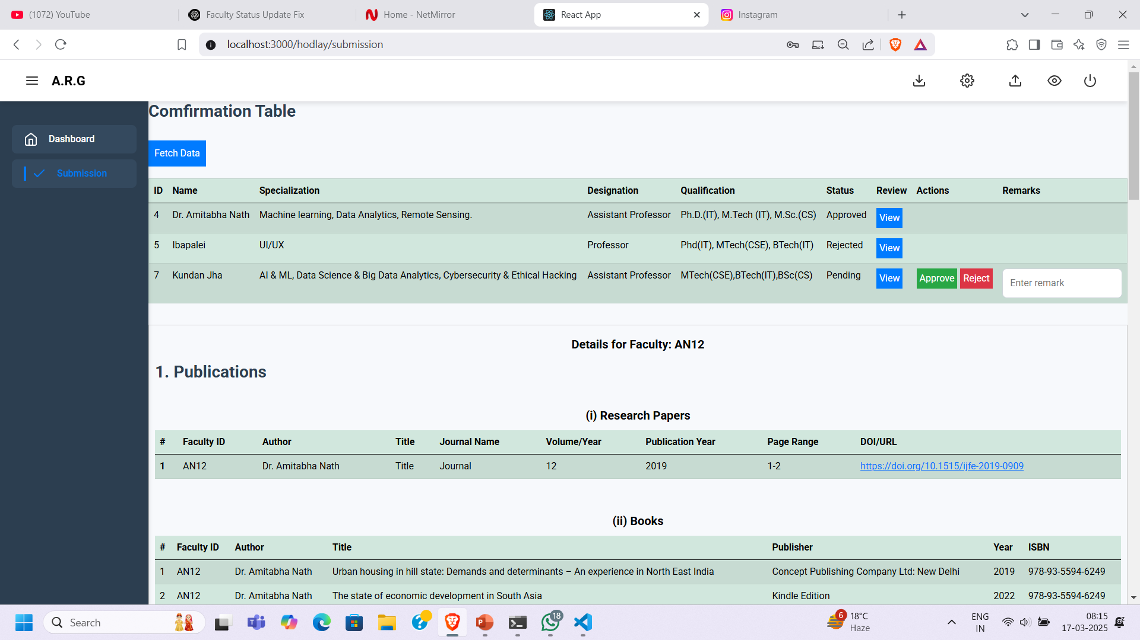
(ii) Accepting/Rejecting faculty data

Slide 36
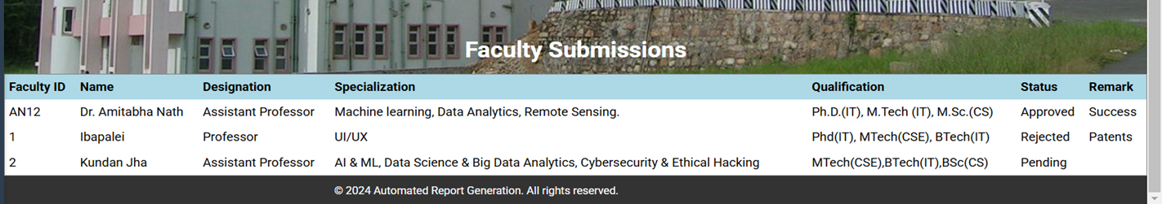
(iii)Providing remarks
which can be seen on the faculty dashboard

Slide 37
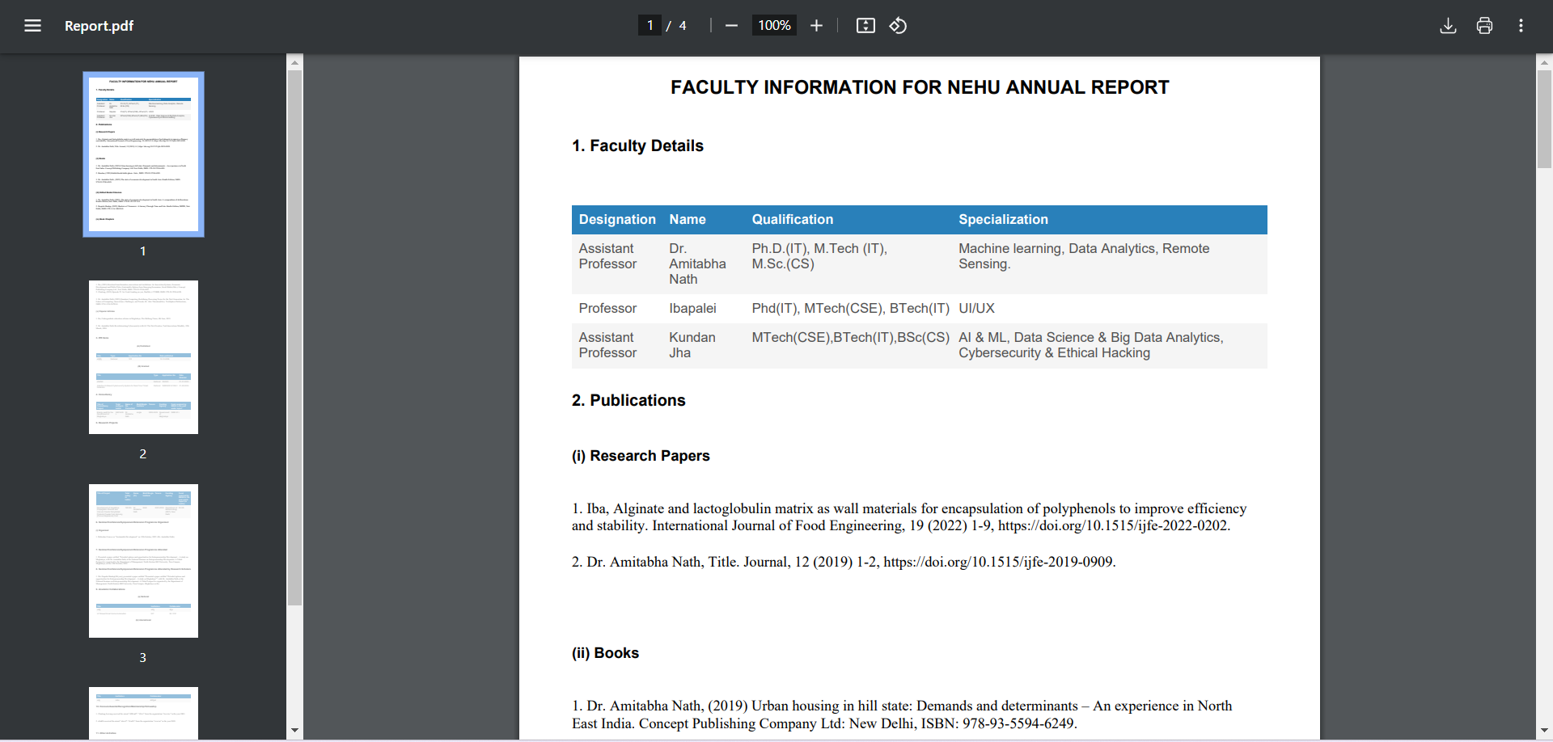
Generated Report

Slide 38

Future Scope
• Department Expansion
• Authentication
• Efficient and secure storage
• Mail based Notifications & Reminders
• Data Visualization

Slide 39

Conclusion
Solves Manual Challenges: Eliminates errors and inefficiencies in manual report generation.
Structured Data Management: Uses a centralized database for organized faculty data collection and retrieval.
Automated Compilation: Simplifies report generation with automated processing and feedback mechanisms.
Time & Effort Reduction: Speeds up faculty data compilation with real-time updates and structured formatting.
User-Friendly Interface: Allows faculty to upload/manage records and administrators to generate reports easily.
Scalability: Can be expanded with additional features based on institutional requirements.

Slide 40

References
• Bootstrap: https://getbootstrap.com/
• Youtube: https://www.youtube.com/
• MySQL: https://www.mysql.com/
• React: https://react.dev/
• Latex: https://www.overleaf.com/

Slide 41
Thank you
Group 4-
1. Kundan Kumar Jha
2. Ibapalei Shadap
3. Georgepaton Marbaniang
4. Chadong Lowang

